Slide 1

Sports Performance Analysis
"Analyzing individual & team performance using data science & visualization"
Presented By : Sakshi A

Slide 2
Agenda
Objective
Dataset Overview
Visualizations
Correlation & Regression
Clustering & Dashboard
StreamLit Application
Project Outcome

Slide 3
Objective :
This project, titled Sports Performance Analysis, focuses on evaluating player and team performance using statistical data. The primary objective is to identify patterns, understand strengths and weaknesses, and suggest tactical improvements. It integrates Python for data processing, Power BI for dashboard creation, and machine learning techniques for pattern discovery. The project combines real-time metrics like goals, speed, and assists with analytical tools to deliver insightful visualizations. Overall, it serves as a comprehensive case of applying data science in sports analytics.

Slide 4
Dataset Overview :
The dataset contains over 10,000 rows of synthetic sports data, covering various sports such as Football, Cricket, and Basketball. Each entry includes detailed player statistics like goals, assists, speed, success rate, minutes played, and rating. Additionally, it captures team-based performance data like matches won or lost. This wide range of features enables comprehensive analysis at both individual and team levels. It is structured to reflect realistic sports scenarios, allowing meaningful machine learning and visualization outcomes.

Slide 5

Visualizations

Slide 6
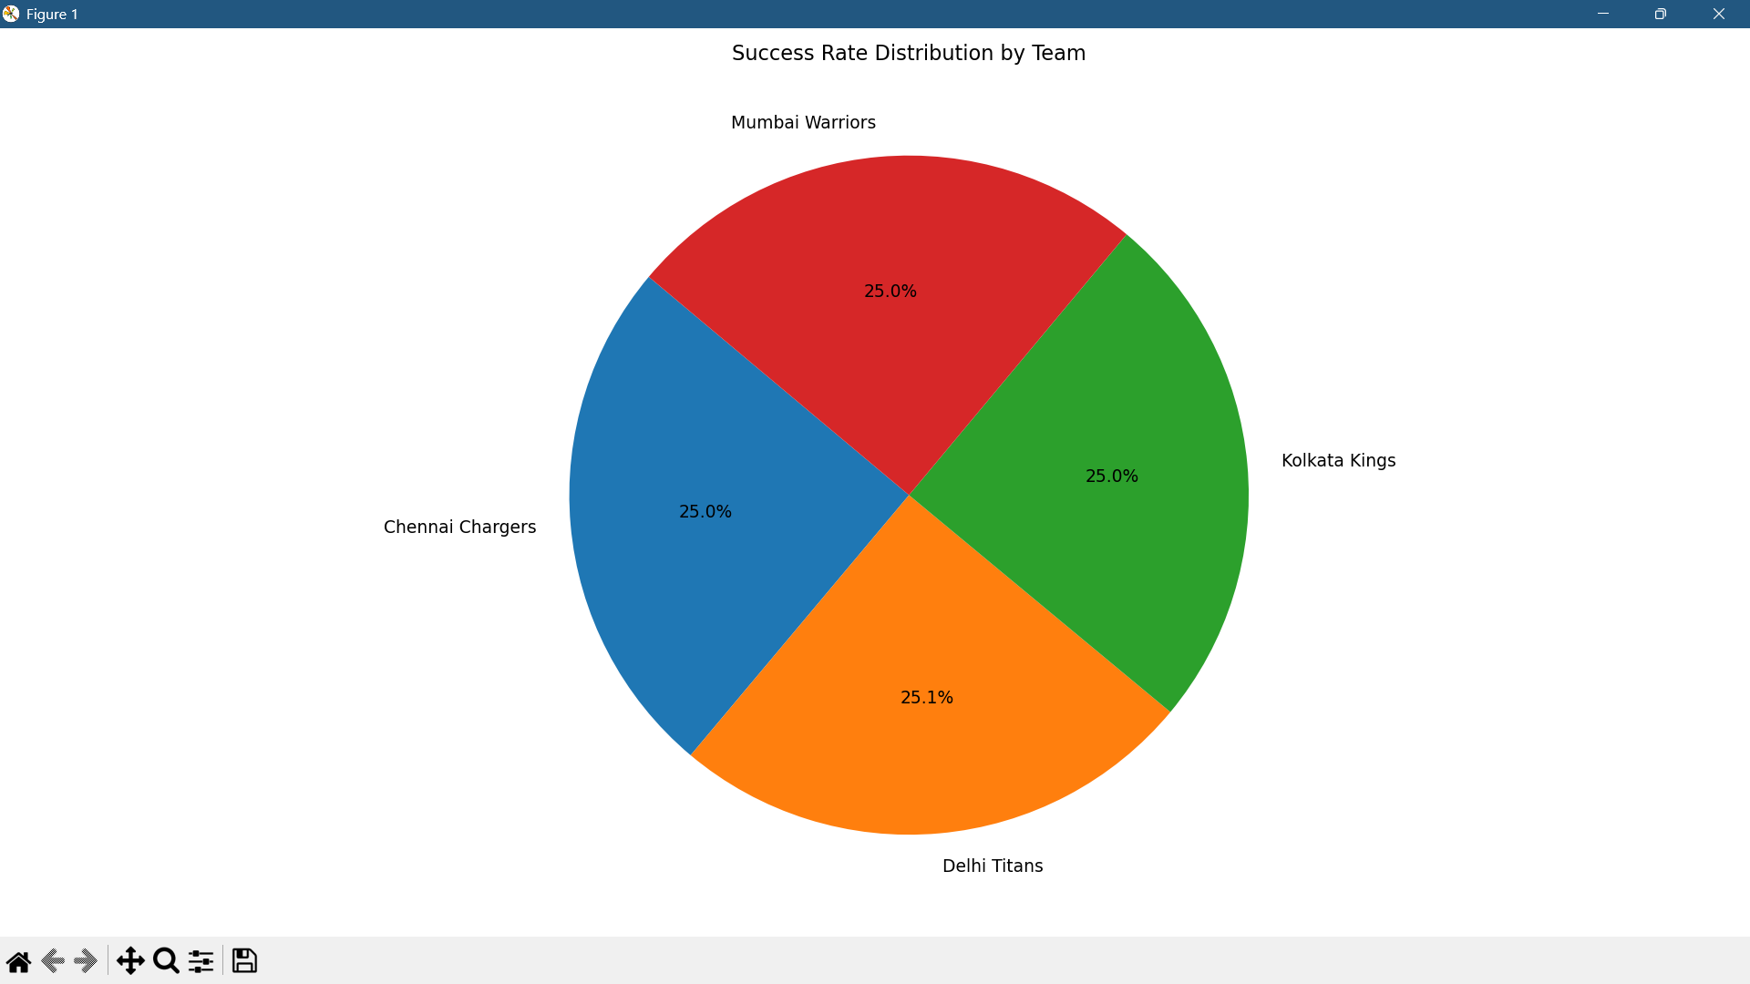
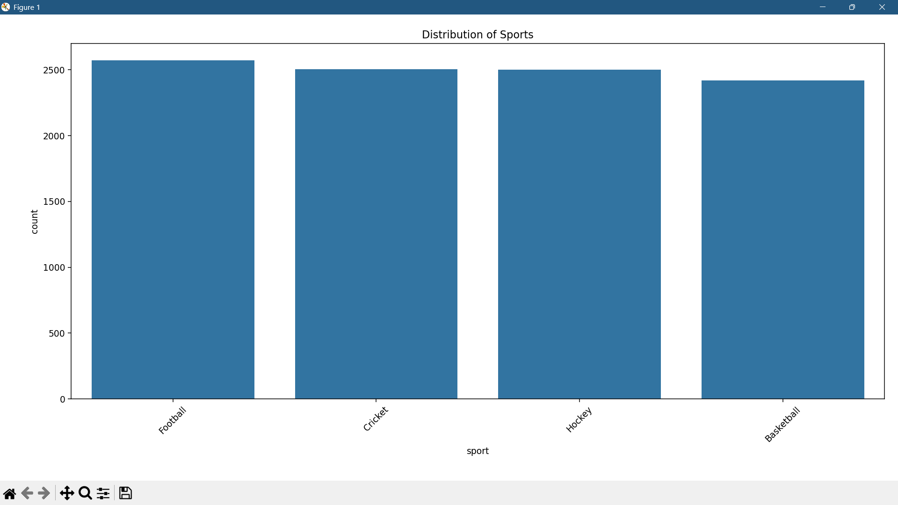
This pie chart illustrates how success is distributed across different teams by calculating the average success rate of each team. It offers a quick comparison of overall team efficiency. This visualization helps identify which teams consistently perform better and which may need strategic improvements.
This count plot displays how many entries belong to each sport, giving an idea of the dataset’s distribution. Sports like Football and Cricket appear more frequently, indicating that the analysis might be more robust for these categories. This visualization helps in assessing data balance before applying clustering or regression.
Distribution of Success Rate & Sport

Slide 7
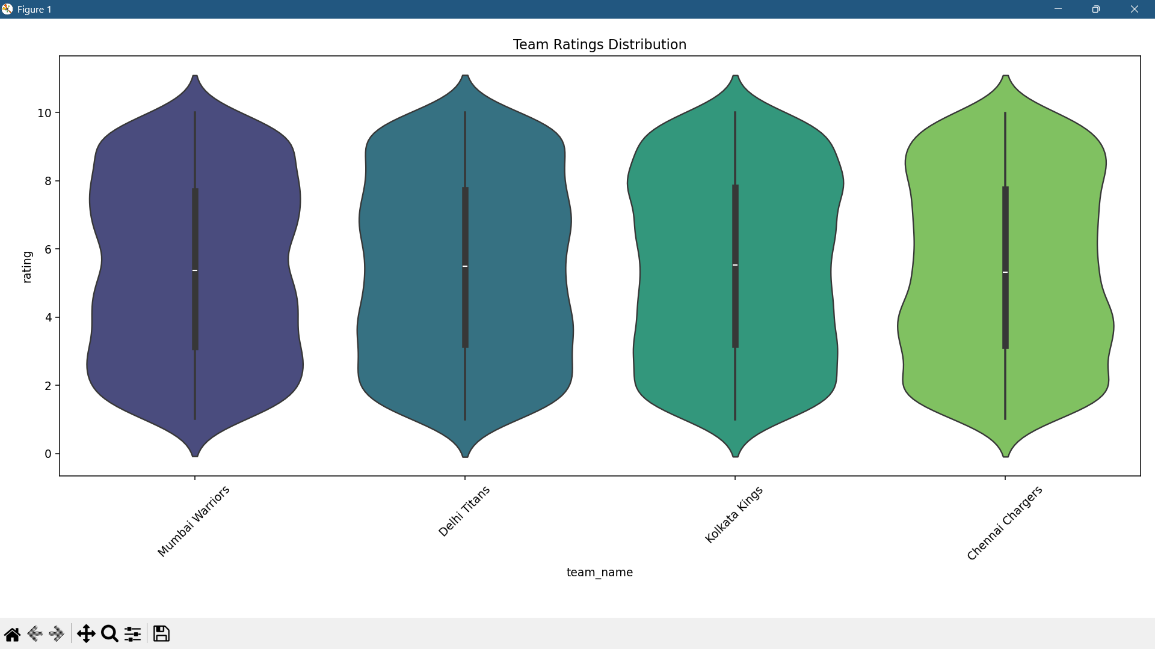
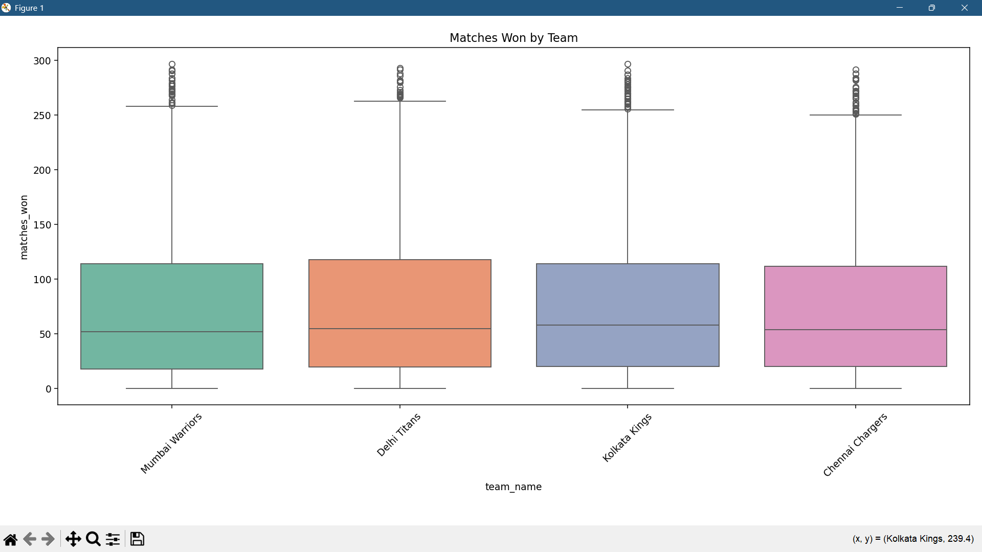
The violin plot shows the distribution of player ratings within each team. It reveals both the spread and density of ratings, helping us understand if a team has a consistent skill level or is highly varied.
This box plot compares the number of matches won by each team, highlighting central tendencies and variability. Teams with high median values are consistent winners, while those with lower medians may struggle with performance.
Rate Distribution & Matches Won

Slide 8

Correlation & Regression

Slide 9
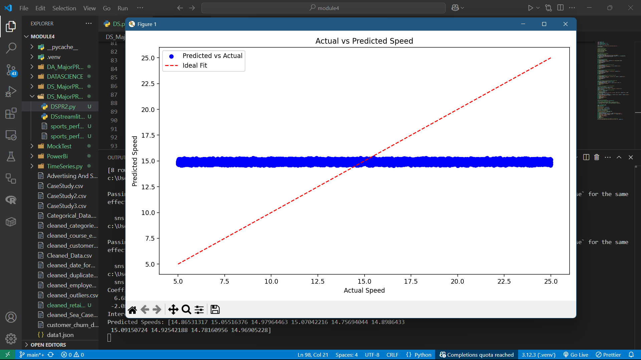
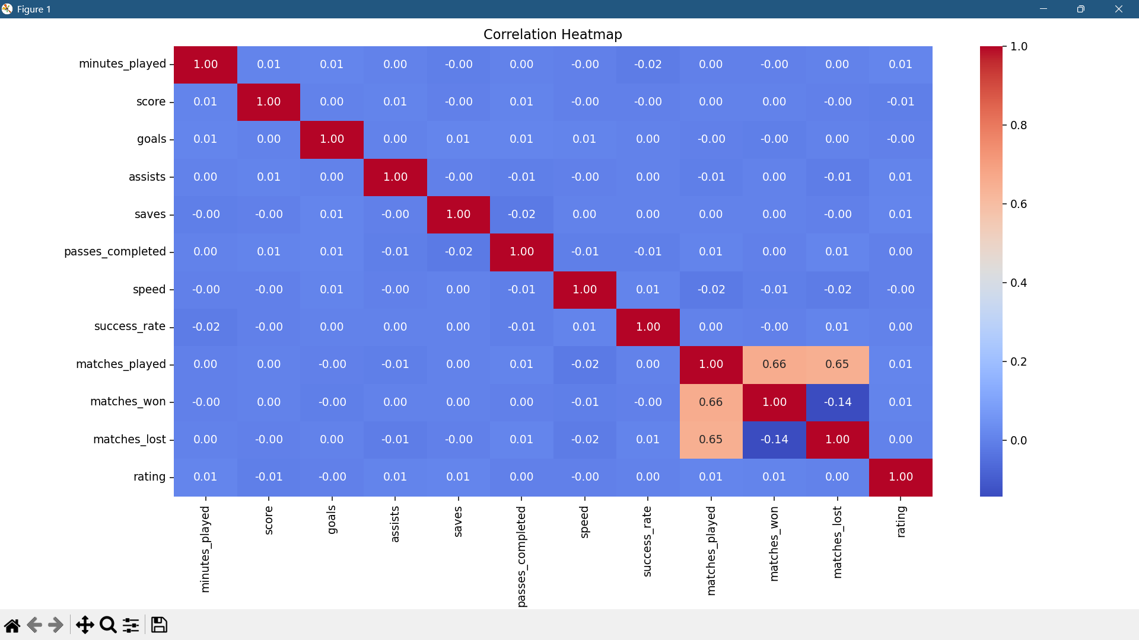
The correlation heatmap visualizes the relationships between all numerical variables in the dataset. Strong correlations, either positive or negative, help in selecting impactful features for modeling. For example, a high correlation between success rate and passes completed implies that passing efficiency contributes significantly to performance. It also reveals multicollinearity, which is important for regression modeling. Overall, this chart guides data scientists in feature engineering and dimensionality reduction.
This slide presents a regression analysis where the objective was to predict the speed of players using various performance-related features. In the scatter plot, the blue dots represent the predicted speed values plotted against the actual speed, while the red dashed line shows the ideal case where predictions would exactly match the actual values. However, the predictions appear almost flat and concentrated around a single value, regardless of the actual speed.
Linear Regression
Correlation Heatmap

Slide 10

Clustering & Dashboard

Slide 11
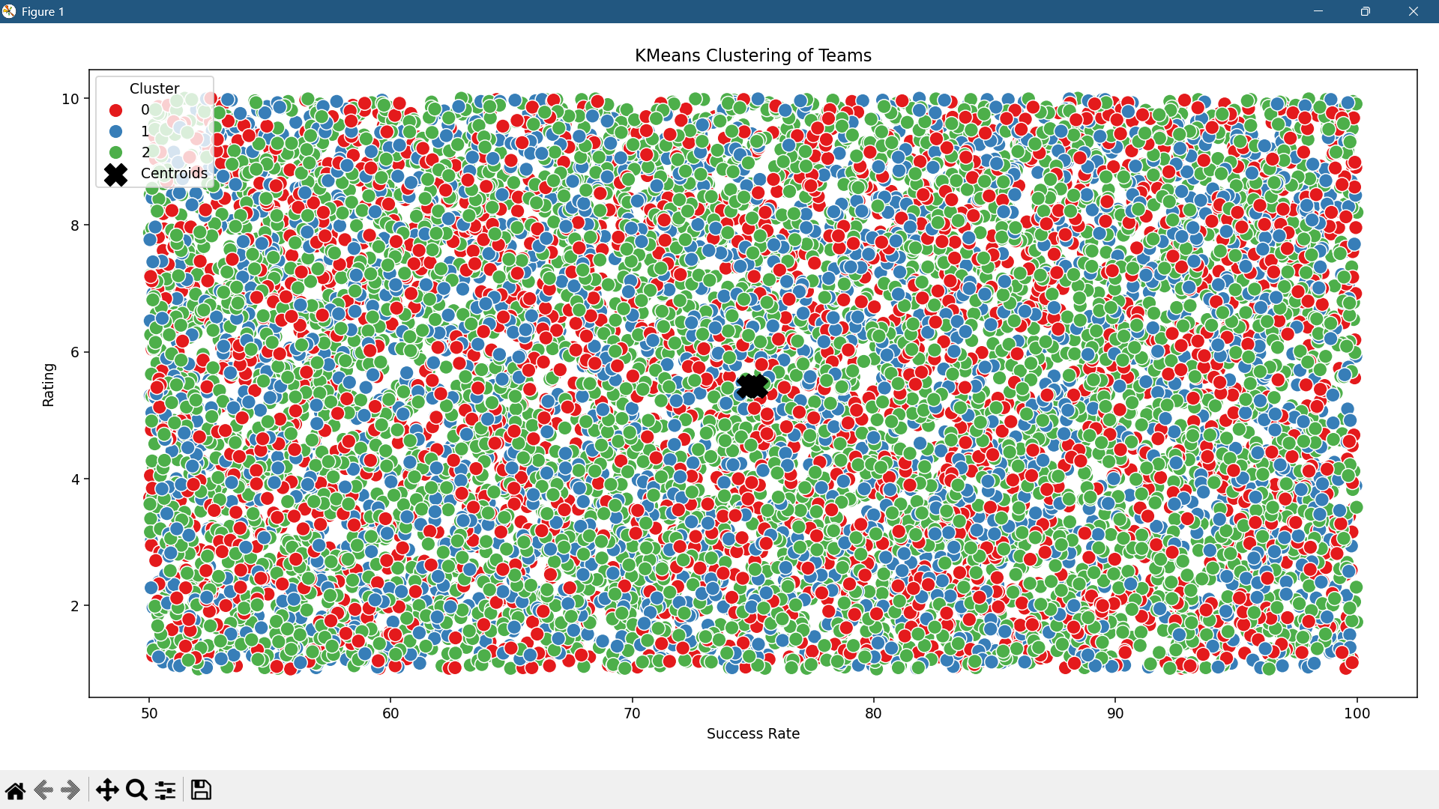
Clustering was conducted using the K-Means algorithm to group similar-performing players or teams. The model used features like success rate, rating, matches won, and lost to assign cluster labels. Each cluster represents a distinct performance segment – for instance, high scorers, balanced players, or underperformers.

Slide 12
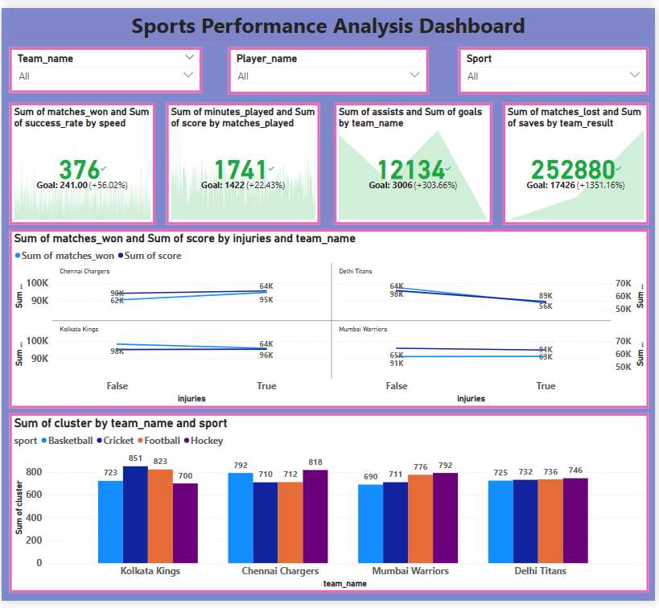
Interactive Filters for Team, Player, and Sport enable focused analysis and real-time visual updates.
KPI Cards display key metrics:
Matches Won & Success Rate by player speed Minutes Played & Score.
Assists & Goals by Team.
Matches Lost & Saves
Injury Analysis (Line Chart) compares team performance with and without injured players.
Clustering by Team & Sport (Bar Chart) shows performance grouping using cluster values.
Performance Insights:
High speed and consistent minutes correlate with better team results.
Assists have a strong influence on overall success.
Injuries negatively affect both matches won and total score.
Cluster distribution helps identify elite vs average teams.

Slide 13
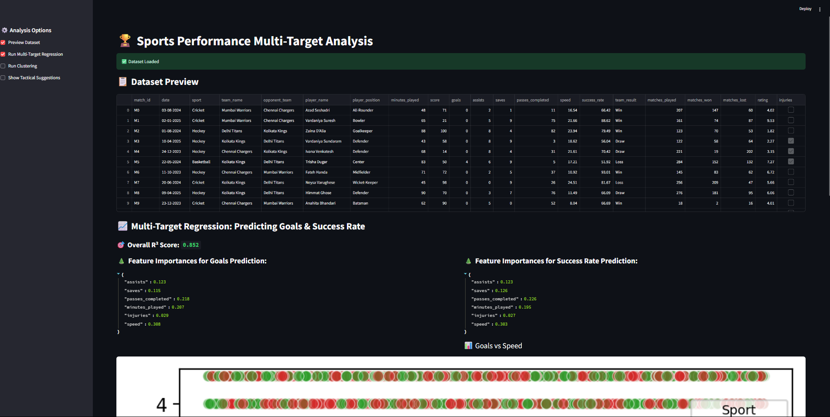
Streamlit App: Sports Performance Analyzer
This interactive web application was built using Streamlit to analyze sports performance data. The app allows users to predict two key performance metrics goals and success rate using multi-output regression powered by a Random Forest model. Features such as assists, passes completed, minutes played, injuries, saves, and speed are used to train the model, and the app displays R² scores and feature importances for both targets. A KMeans clustering section groups players based on performance attributes to help identify high-potential or underperforming players. The app also offers tactical suggestions, listing top scorers and efficient players based on calculated stats. Through its clean interface and integrated charts (scatterplots, bar graphs), the app provides valuable insights without requiring any coding making it ideal for coaches, analysts, and data science enthusiasts alike.

Slide 14
Project Outcome :
This project successfully combined data visualization, machine learning, and domain knowledge to analyze sports performance. A Power BI dashboard offered intuitive insights, while clustering and regression revealed deeper patterns. We identified key performance drivers and provided tactical recommendations for both individual players and teams. The outcomes demonstrate the power of data science in transforming raw statistics into meaningful strategies. It shows that sports analytics is not just about numbers — it's about better performance through insights.

Slide 15
THANK YOU!!

